Slide 1
V3.4 Basic premise

Slide 2
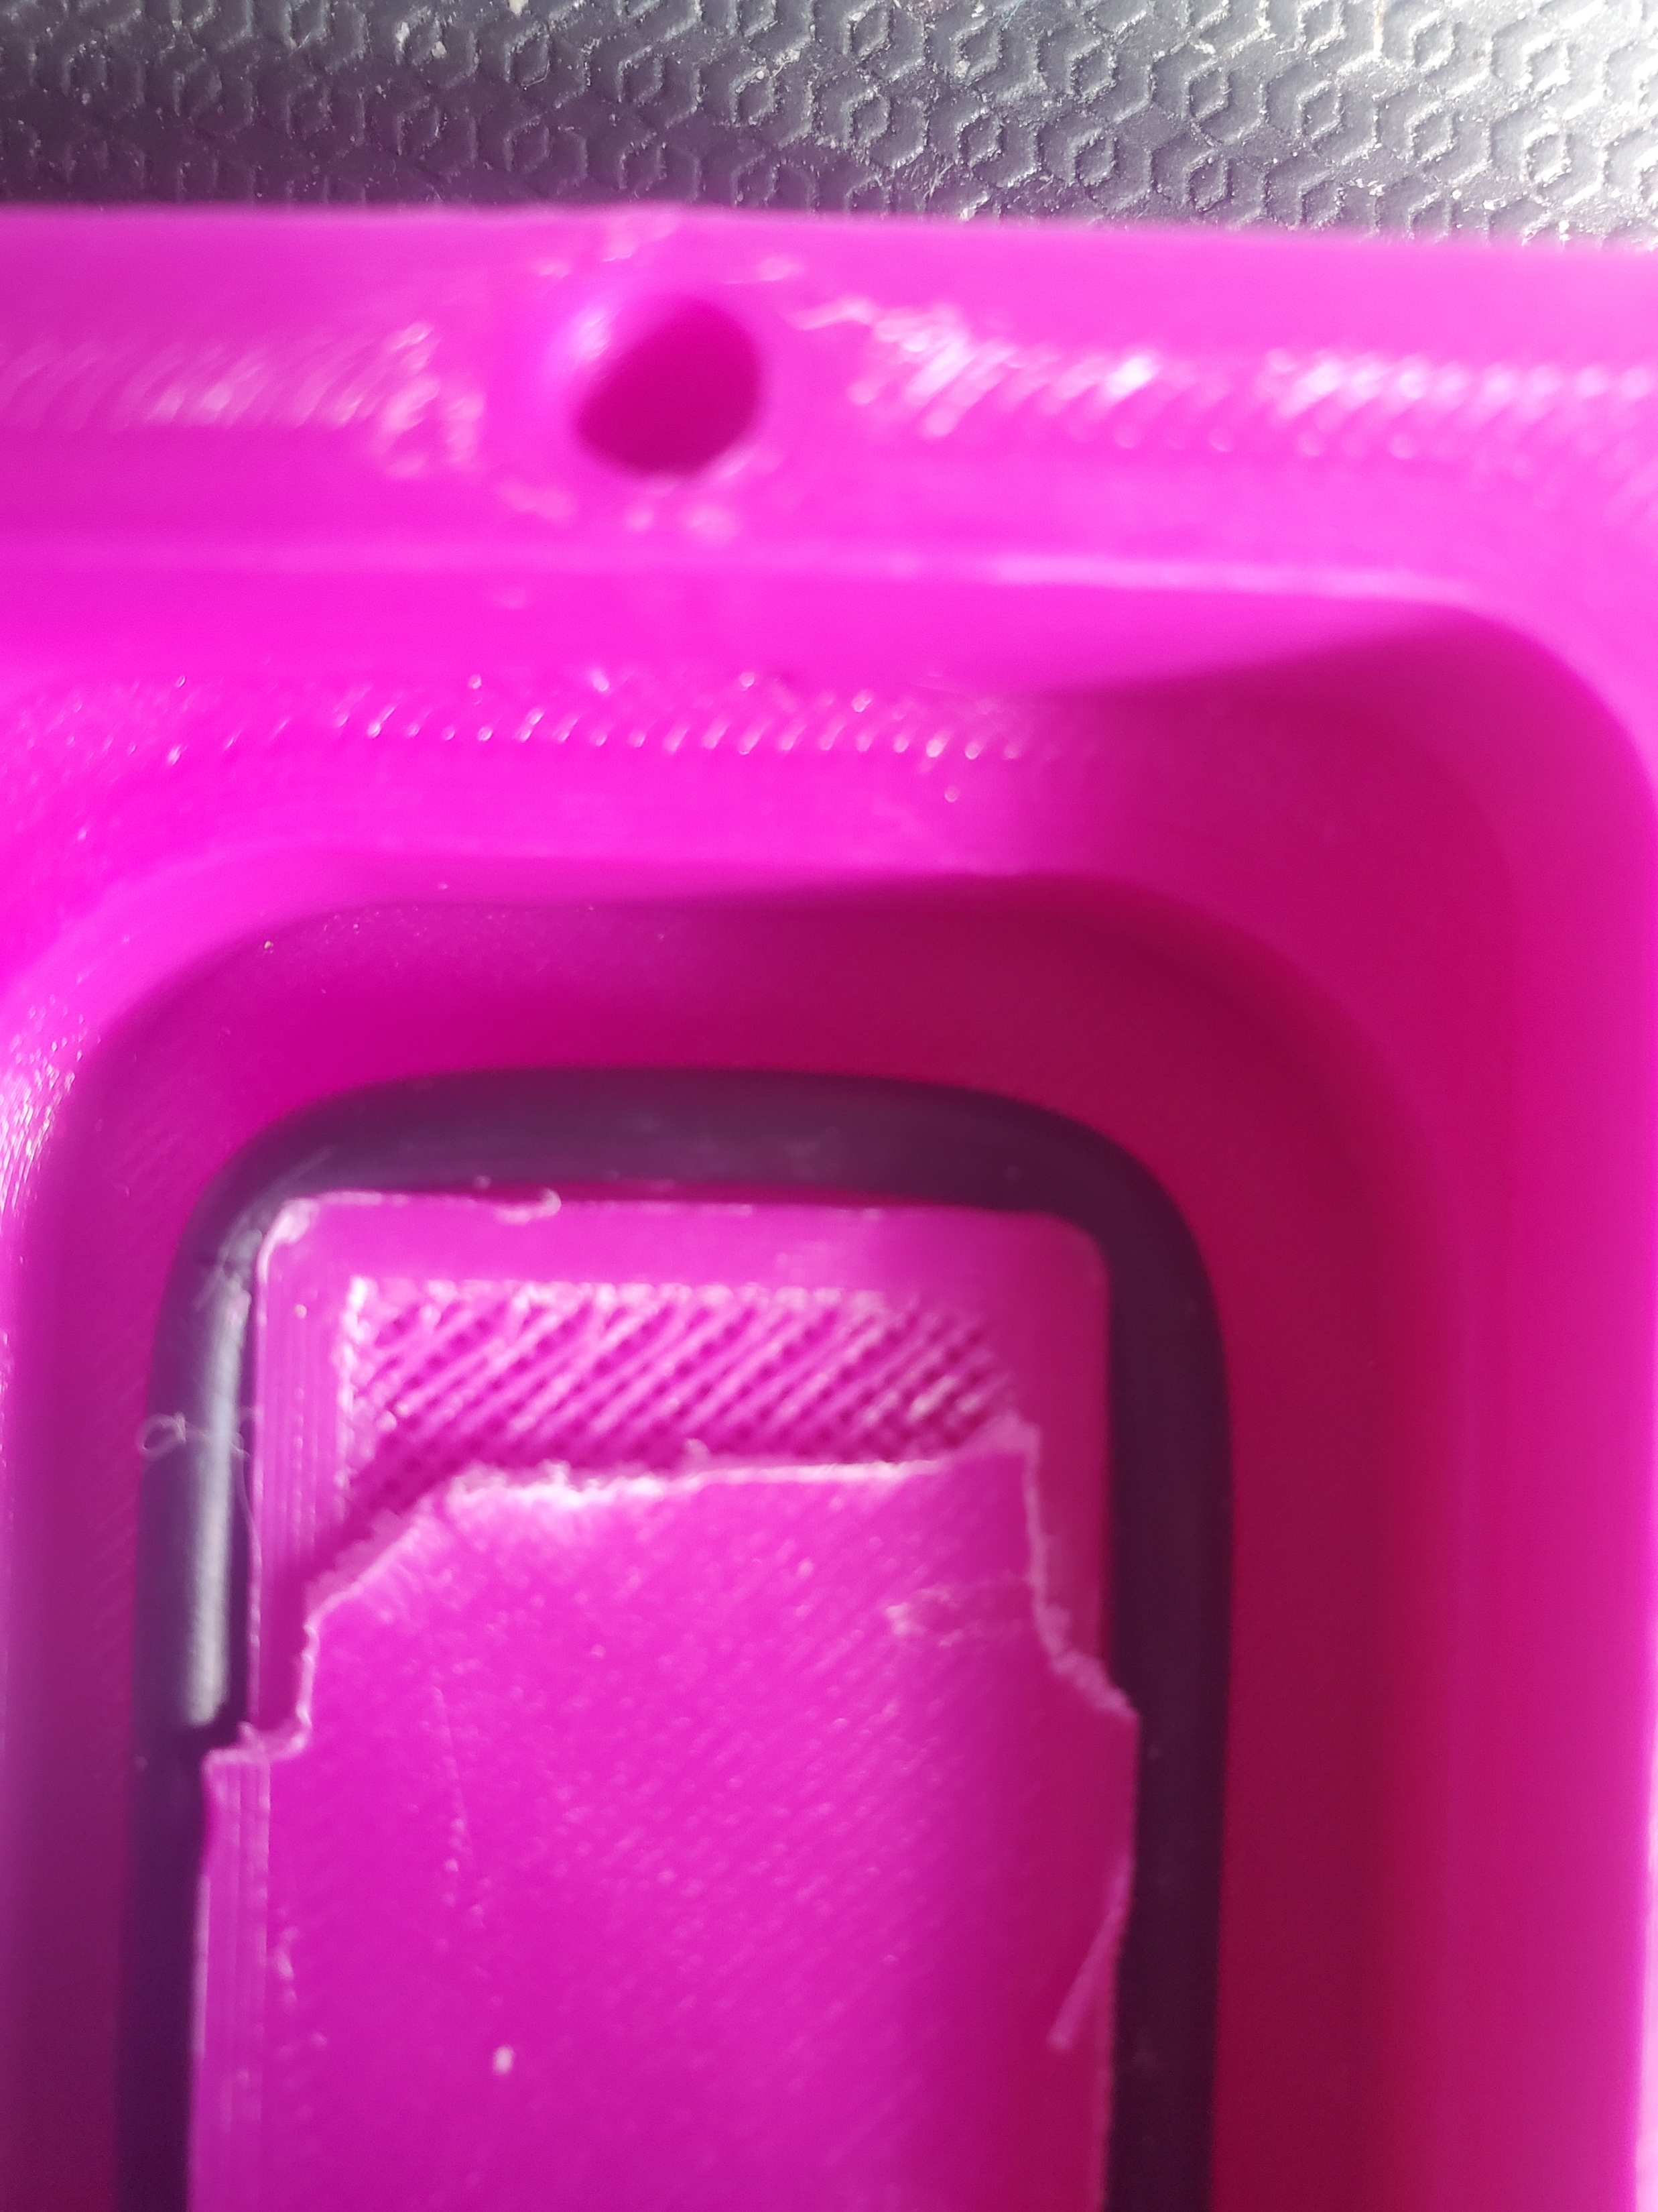
Oring seal
Issue does not seem to be resolved where I can squeeze more to get a tight seal.
After breaking model open, I can see the issue now.
Tight turn radius interior plastic is stopping the oring from getting a nice seal
Proposed change: remove fillets and insert a bull nose on the edge in place of it.

Slide 3
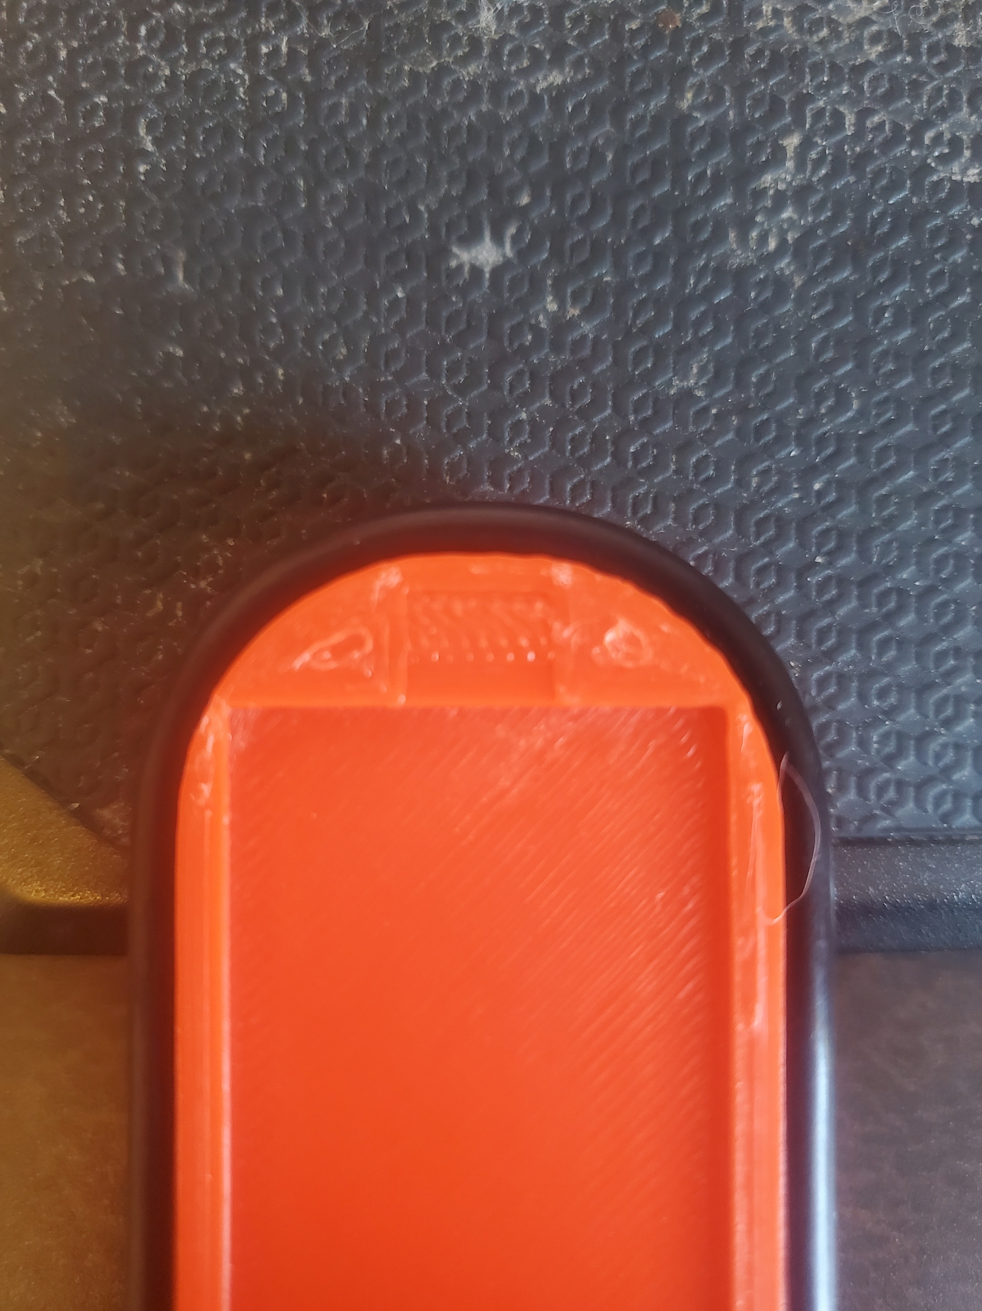
New fillets
Way better fit. I hit 13.7mm fillets with 3.5mm dia rings. The engineering recommendation is at least 3x dia and closer to 6 is better.
I have a 2.6mm inset for the channel.
60mm oring fits nicely

